Slide 1
AASD4011: Adv. Mathematical Concepts for Deep Learning
Dropout

Slide 2
Dropout
Dropout is a regularization technique for reducing overfitting in artificial neural networks.
The method works by randomly "dropping out," or turning off, a proportion of neurons during training.
This has the effect of making the model more robust, as it has to learn to make predictions with a less-than-complete view of the input data.

Slide 3
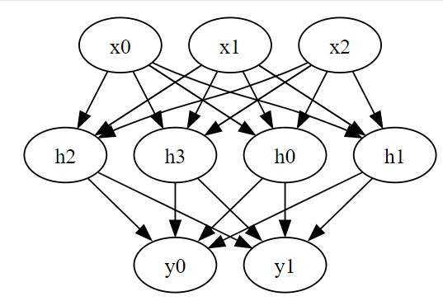
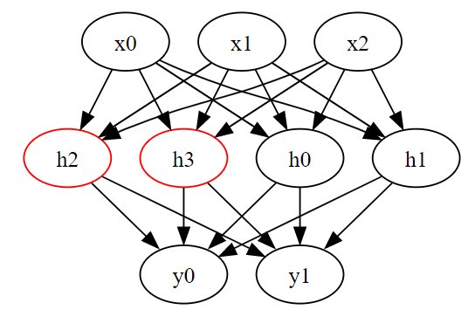
Dropout
Neural Network without Dropout
Neural Network with Dropout
This graph depicts the same neural network, but now with dropout applied. Some nodes in the hidden layer are turned off randomly, indicating the effect of the dropout algorithm. The turned-off nodes do not contribute to the network during a specific iteration of training.

Slide 4
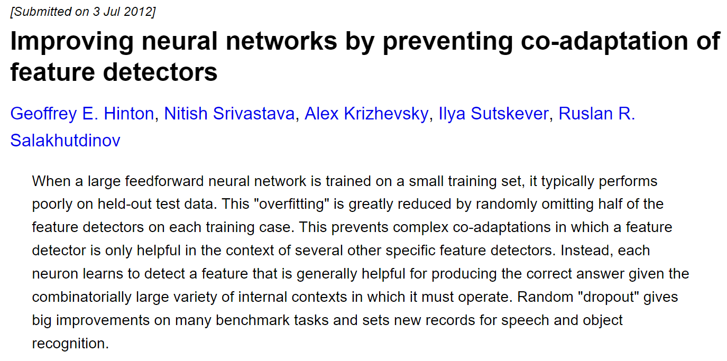
Dropout
https://arxiv.org/abs/1207.0580

Slide 5
Dropout - Implementation
Tensorflow
PyTorch
from tensorflow.keras.models import Sequential
from tensorflow.keras.layers import Dense, Dropout
model = Sequential([
Dense(64, activation='relu', input_shape=(10,)),
Dropout(0.5),
Dense(2)
])
import torch
from torch import nn
class Model(nn.Module):
def __init__(self): super(Model, self).__init__()
self.layer1 = nn.Linear(10, 64)
self.layer2 = nn.Dropout(0.5)
self.layer3 = nn.Linear(64, 2)
def forward(self, x):
x = torch.relu(self.layer1(x))
x = self.layer2(x)
x = self.layer3(x)
return x
model = Model()
In both implementations, the Dropout layer is active only during training, and not during inference.

Slide 6
Dropout - Implementation
The Dropout layer randomly sets a fraction rate of the input units to 0 at each update during training time, which helps prevent overfitting.
With 50% dropout rate - approximately half of the activations of the neurons in the previous layer will set to 0 during a given training step.
In each training step, a new random sample is taken.

Slide 7
Dropout – Common Values
The typical values of dropout rates used in practice usually range from 0.2 to 0.5. However, the optimal value can vary depending on the specific dataset and model architecture, and it's often chosen via hyperparameter tuning. Here's a general guideline:
0.2 - 0.3: A good starting point for simple models and small datasets.
0.4 - 0.5: Commonly used with complex models and larger datasets to prevent overfitting.
Dropout is a regularization technique, and like all regularization techniques, the goal is to prevent overfitting the model to the training data. Therefore, if your model is underfitting, you might want to reduce the dropout rate or remove the dropout layers. Conversely, if your model is overfitting, increasing the dropout rate might help.

